Slide 1
CSG2A3
ALGORITMA dan STRUKTUR DATA
STACK - INFIX, PREFIX, POSTFIX

Slide 2
Pengertian
Infix, Prefix dan Postfix adalah cara penulisan dari notasi matematika yang terdiri dari operator dan operand
Prefix dan Postfix lebih mudah untuk dilakukan komputasi di komputer

Slide 3
Infix, Postfix and Prefix Expressions
INFIX:
  operands surround the operator,
  x+y, 6*3 etc.
POSTFIX:
  Reverse Polish Notation (RPN).
  operator comes after the operands,
  xy+, xyz+* etc.
PREFIX:
  Polish notation.
  operator comes before the operands,
  +xy, *+xyz etc.

Slide 4
Why use Prefix or Postfix
INFIX notations are not as simple as they seem specially while evaluating them.
To evaluate an infix expression we need to consider Operators’ Priority and Associative property
  For example expression 3+5*4 evaluate to 32 i.e. (3+5)*4 or to 23 i.e. 3+(5*4).

Slide 5
Infix Expression Is Hard To Parse
Need operator priorities, tie breaker, and delimiters.
This makes computer evaluation more difficult than is necessary.
Postfix and prefix expression forms do not rely on operator priorities, a tie breaker, or delimiters.
So it is easier to evaluate expressions that are in these forms.

Slide 6
Properties
Operator Priorities
  priority(*) = priority(/) > priority(+) = priority(-)
Tie Breaker
  When an operand lies between two operators that have the same priority, the operand associates with the operator on the left.

Slide 7
Examples of infix to prefix and post fix
Infix | PostFix | Prefix
A+B | AB+ | +AB
(A+B) * (C + D) | AB+CD+* | *+AB+CD
A-B/(C*D^E) | ABCDE^*/- | -A/B*C^DE

Slide 8
Example : Infix to Postfix
2*3/(2-1)+5*3
Rules:
Operand, no push, “print” only
Operator, push to stack (if op. has higher precedence than top, or pop & push if lower/same)
Delimiter, push (opening) or pop & “print" (closing) until opening delim. found. Delimiter is not printed.
Expression
 | Stack
(bottom stack)
Output
2
*
3
/
(
2 /( 23*2
- /(- 23*2
1 /(- 23*21
) / 23*21-
+ + 23*21-/
5 + 23*21-/5
* +* 23*21-/5
3 +* 23*21-/53
Empty 23*21-/53*+
Empty
*
*
/
/(
2
2
23
23*
23*
CDK2AAB4 – STRUKTUR DATA
Notes:
2 == constant then print → stack = empty → 2
* == operator then push because empty → stack = * → 2
3 == constant then print → stack = * → 23
/ == operator then pop and push because / precedence is not higher than top → stack = / → 23*
( == delimiter then push because it is opening delimiter → stack = /( → 23*
2 == constant then print → stack = /( → 23*2
- == operator then push because top is opening delimiter → stack = /(- → 23*2
1 == constant then print → stack = /(- → 23*21
) == delimiter then pop and print until opening delimiter is found → stack = / → 23*21-
+ == operator then pop and push because + precedence is not higher than top → stack = + → 23*21/
5 == constant then print → stack =+ → 23*21/5
* == operator then push because * operator is higher than top → stack = +* → 23*21/5
3 == constant then print → stack =+* → 23*21/53
Pop all → stack = empty → 23*21/53*+

Slide 9
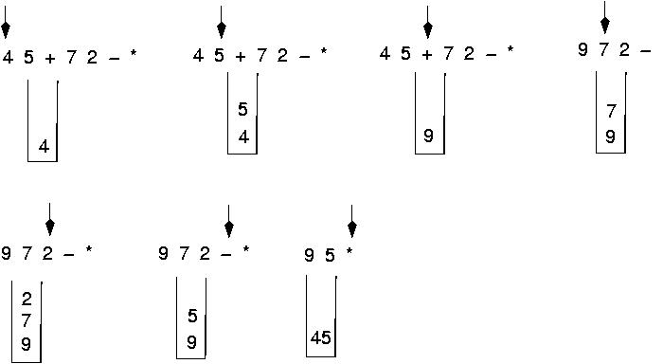
Evaluating a postfix Expression
Use a stack to evaluate an expression in postfix notation

Slide 10
Example : Postfix Evaluation
45+72-*
Rules:
Operand, push
Operator, pop & evaluate, push evaluation result
Expression
 | Stack
(bottom stack)
4
5
+
7
2
- 9 5
* 45
4
4 5
9
9 7
9 7 2
CDK2AAB4 – STRUKTUR DATA
Notes:
4 == constant then push → stack = 4
5 == constant then push → stack = 4 5
+ == operator then pop, pop, evaluate, then push eval. result → stack = 9
7 == constant then push → stack = 9 7
2 == constant then push → stack = 9 7 2
- == operator then pop, pop, evaluate, then push eval. result → stack = 9 5
* == operator then pop, pop, evaluate, then push eval. result → stack = 45

Slide 11
Evaluation: Postfix to Infix
Evaluate the postfix expression: AB+CD-*
Start scanning from left to right →
D
B
C
C
C-D
A
A
A+B
A+B
A+B
A+B
A+B*C-D
Push A
(operand)
Push B
(operand)
Operator + Pop 2 elements A+B
Push A+B
Push C
(operand)
Push D
(operand)
Operator – Pop 2 elements C-D
Push C-D
Operator * Pop 2 elements A+B*C-D
Push A+B*C-D
CDK2AAB4 – STRUKTUR DATA
Notes:
4 == constant then push → stack = 4
5 == constant then push → stack = 4 5
+ == operator then pop, pop, evaluate, then push eval. result → stack = 9
7 == constant then push → stack = 9 7
2 == constant then push → stack = 9 7 2
- == operator then pop, pop, evaluate, then push eval. result → stack = 9 5
* == operator then pop, pop, evaluate, then push eval. result → stack = 45

Slide 12
Infix to Prefix
Reverse the expression
  - Delimiter opening convert to closing and closing to opening.
Convert to Postfix
  But if operator, push if operator has higher/same precedence with the top, or pop & push if lower.
Reverse the output
CDK2AAB4 – STRUKTUR DATA

Slide 13
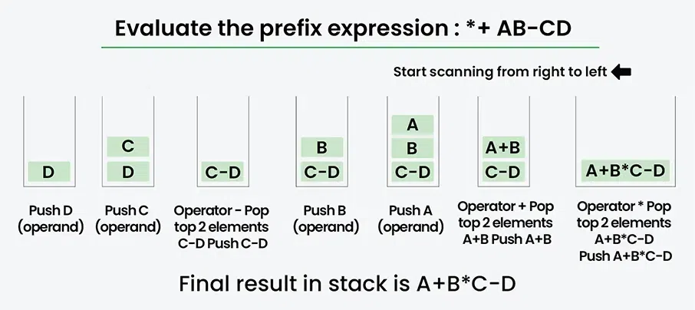
Evaluation Example: Prefix to Infix
CDK2AAB4 – STRUKTUR DATA

Slide 14
Evaluation Example: Prefix to Infix
CDK2AAB4 – STRUKTUR DATA

Slide 15
Evaluation Example: Prefix to Infix
CDK2AAB4 – STRUKTUR DATA

Slide 16
Evaluation Example: Prefix to Infix
CDK2AAB4 – STRUKTUR DATA

Slide 17
Evaluation Example: Prefix to Infix
CDK2AAB4 – STRUKTUR DATA

Slide 18
Evaluation Example: Prefix to Infix
CDK2AAB4 – STRUKTUR DATA

Slide 19
Evaluation Example: Prefix to Infix
CDK2AAB4 – STRUKTUR DATA

Slide 20
Evaluation Example: Prefix to Infix
CDK2AAB4 – STRUKTUR DATA

Slide 21
Evaluation Example: Prefix to Infix
CDK2AAB4 – STRUKTUR DATA

Slide 22
Evaluation Example: Prefix to Infix
CDK2AAB4 – STRUKTUR DATA

Slide 23
Evaluation Example: Prefix to Infix
CDK2AAB4 – STRUKTUR DATA

Slide 24
Evaluation Example: Prefix to Infix
CDK2AAB4 – STRUKTUR DATA

Slide 25
Evaluation Example: Prefix to Infix
CDK2AAB4 – STRUKTUR DATA

Slide 26
Evaluation Example: Prefix to Infix
CDK2AAB4 – STRUKTUR DATA

Slide 27
Evaluation Example: Prefix to Infix
CDK2AAB4 – STRUKTUR DATA

Slide 28
Train Your Brain
Suppose the notation already presented in double linked list.
  Write an algorithm to convert an infix expression to postfix and infix to prefix
  Write an algorithm to evaluate a postfix and a prefix expression
Use following functions/procedures to solve those problems
  isNumber, to check whether input is number
  isOperator, to check whether input is operator
  degree, return degree of operator
  merge, merge input parameter into one text

Slide 29
Infix to postfix
val: infotype
P = L.first
while (P != Nil) do
if (isNumber(P->info)) then
Output(P->info)
else if (P->info = '(') then
push(S, P->info)
else if (P->info = ')') then
while (!isEmpty(S)) && (S.info[S.Top] != '(') do
pop(S, val)
Output(val)
endwhile
pop(S, val)
else if (isOperator(P->info)) then
while (!isEmpty(S)) && (S.info[S.Top] != '(') && (degree(P->info) <= degree(S.info[S.Top])) do
pop(S, val)
Output(val)
endwhile
push(S, P->info)
P = P->next
endwhile

Slide 30
Infix to prefix
val: infotype
P = L.last
while (P != Nil) do
if (isNumber(P->info)) then
Output(P->info)
else if (P->info = '(') then
push(S, P->info)
else if (P->info = ')') then
while (!isEmpty(S)) && (S.info[S.Top] != '(') do
pop(S, val)
Output(val)
endwhile
pop(S, val)
else if (isOperator(P->info)) then
while (!isEmpty(S)) && (S.info[S.Top] != '(') && (degree(P->info) < degree(S.info[S.Top])) do
pop(S, val)
Output(val)
endwhile
push(S, P->info)
P = P->prev
endwhile

Slide 31
Postfix evaluation
operand1: infotype
operand2: infotype
operator: infotype
result: infotype
P = L.first
while (P != Nil) do
if (isNumber(P->info)) then
push(S, P->info)
else if (isOperator(P->info)) then
operator = P->info
pop(S, operand2)
pop(S, operand1)
result = operand1 + operator + operand2
push(S, result)
P = P->next

Slide 32
Prefix evaluation
operand1: infotype
operand2: infotype
operator: infotype
result: infotype
P = L.last
while (P != Nil) do
if (isNumber(P->info)) then
push(S, P->info)
else if (isOperator(P->info)) then
operator = P->info
pop(S, operand2)
pop(S, operand1)
result = operand1 + operator + operand2
push(S, result)
P = P->prev

